Slide 1

Selecting a list to support
Gruppo GEA - Cineca

Slide 2
Selecting a list
Choosing the list is the phase whereby signatures are collected in support of a particular list
When the required number of preferences is achieved, the list becomes complete and can be transmitted to the voting system

Slide 3
Selecting a list
The following are the main stages in selecting a list:
Log in to the system
Click on Sottoscrizione (Select)
Select the list
Select the governing body
Confirm selection

Slide 4
Selecting a list
Log in to the system
Access the Reserved Area using your university credentials
Visualize the Menu (right-hand side)
Click on «Student Elections»

Slide 5
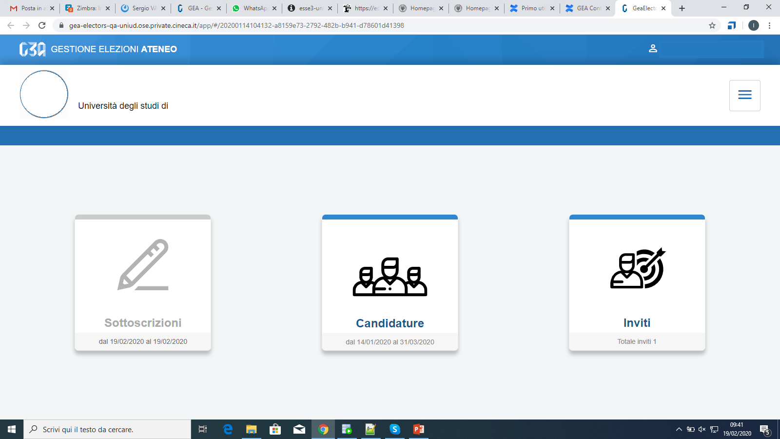
Selecting the list
Select the Sottoscrizioni (Confirm selection) button

Slide 6
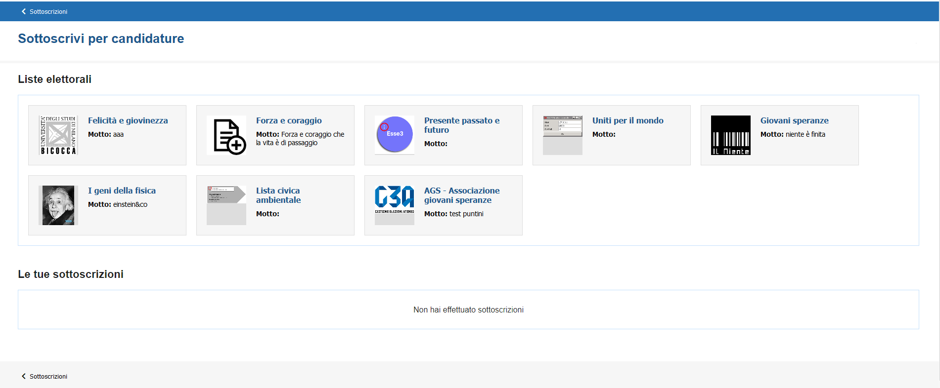
Selecting the list
This section summarizes your choices.
At the initial stage, such a list will be empty.
All the lists subsequently chosen will then be listed here.

Slide 7
Selecting the list
Indicate your preferred list

Slide 8
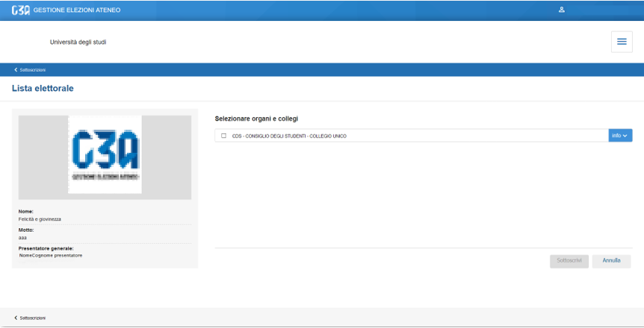
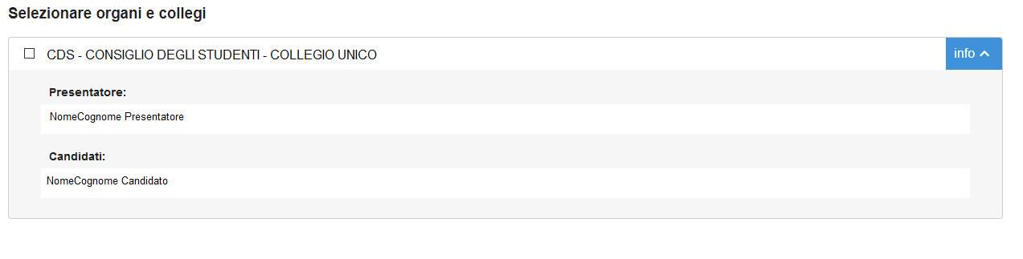
Selecting the list
By clicking on the 'info' button, you can view the details of the list: presenter and candidates

Slide 9
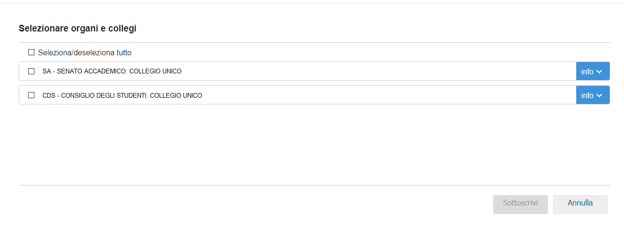
Selecting the list
If the list has been submitted for multiple bodies, all of these would be listed in this section.

Slide 10
Selecting the list
Select the preferred governing body

Slide 11
Selecting the list
Click on the «Sottoscrivere» (Select) button
You are returned to the home page after confirming your selection

Slide 12
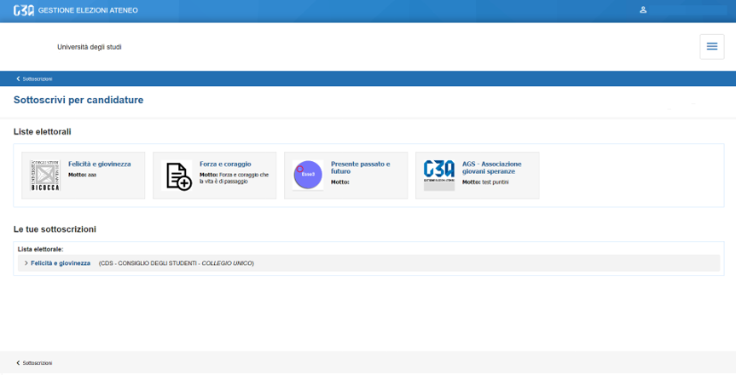
Selecting the list
List of preferences

