Slide 1
Guidelines: your pre-enrolment application
Guidelines about your pre-enrolment application through the
Universitaly portal

Slide 2
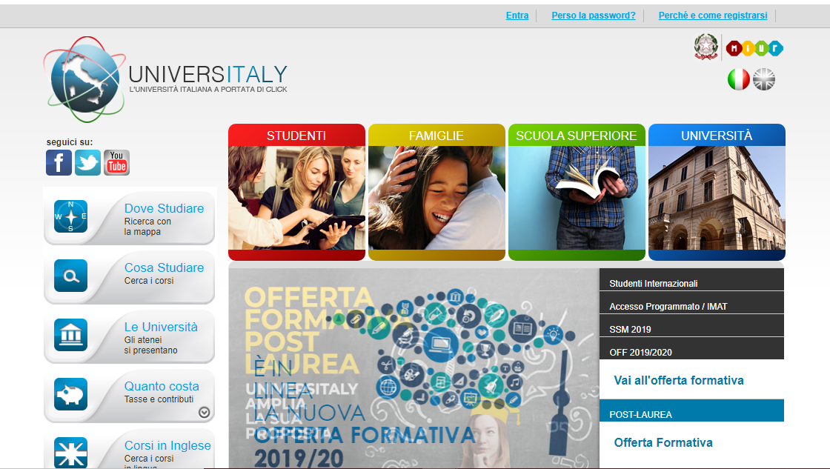
Select the portal language
Select English
Do not use the browser translation system, it may cause technical issues and you will be sent all the following communication in italian

Slide 3
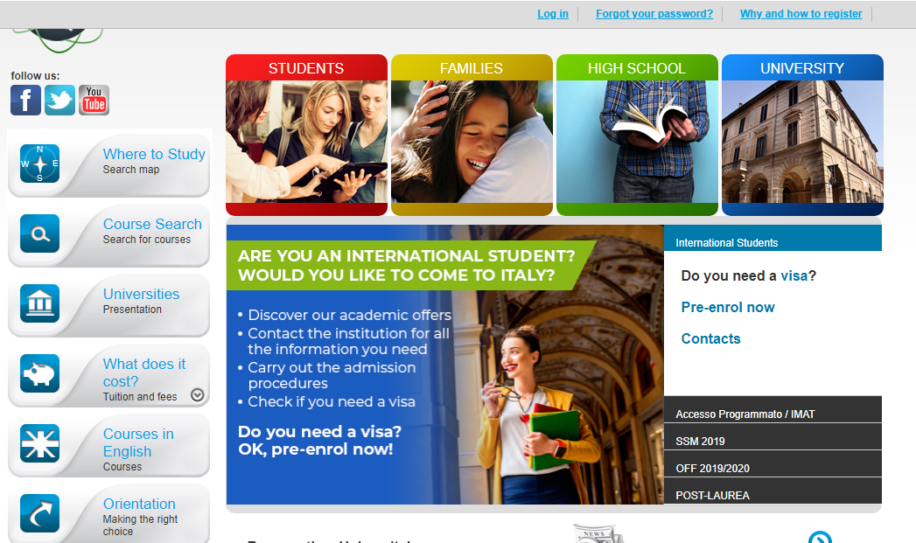
Pre-enrol now
Select
International Students
And
Pre-enrol now
Please note that at one point you will be asked which embassy or consulate you are going to use for your visa application: select visa for more information about Italian Representative in your country

Slide 4
Registration
You need to register to Universitaly
It’s preferable using the same email address you used to contact us. It will make easier to indentify you.
Please note that you will need to confirm you email address to complete your registration

Slide 5
Registration: fiscal code
The procedure prompts to enter your Italian tax code
If you do not have an italian fiscal code, click on save: the system will show show a pop up with a a new one based on the personal data you input
Click on the code to add it to your registration

Slide 6
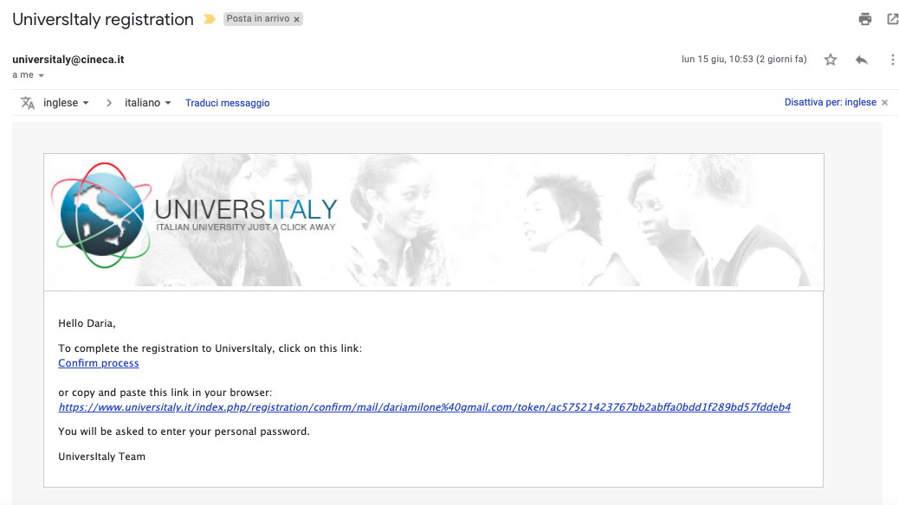
Registration: confirm your email address
You will receive an email from universitaly@cineca.it
You need to confirm you email address following the instructions
If you did not set the language the email will be in Italian

Slide 7
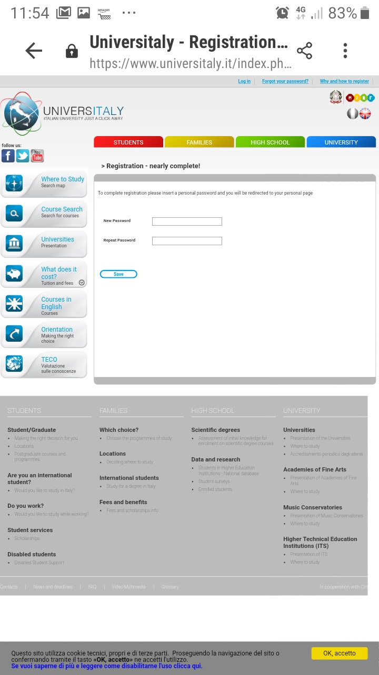
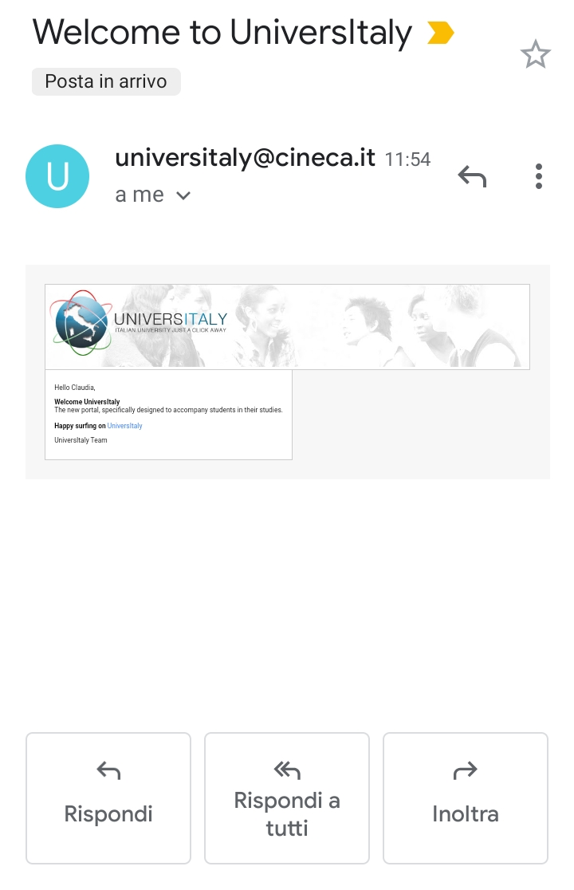
Registration: password
Choose your password and log in!
You will be sent a welcome email!

Slide 8
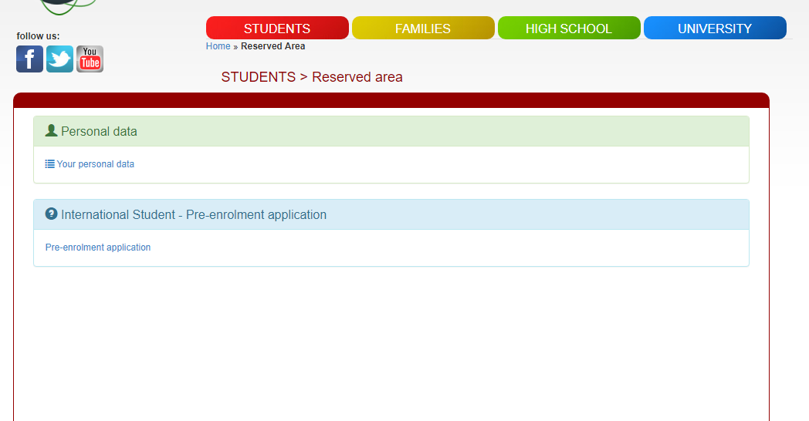
Log In: Reserved Area
Go to Pre-enrollment application.
You will be asked to confirm your personal data anyway
You will be ask to upload:
A photo
A scan copy of your passport
Documents proving your education (transcript of records, study diploma, certificates of degree accomplishment). No need to upload the DoV if you do not already have it - we need it upon enrolment.

Slide 9
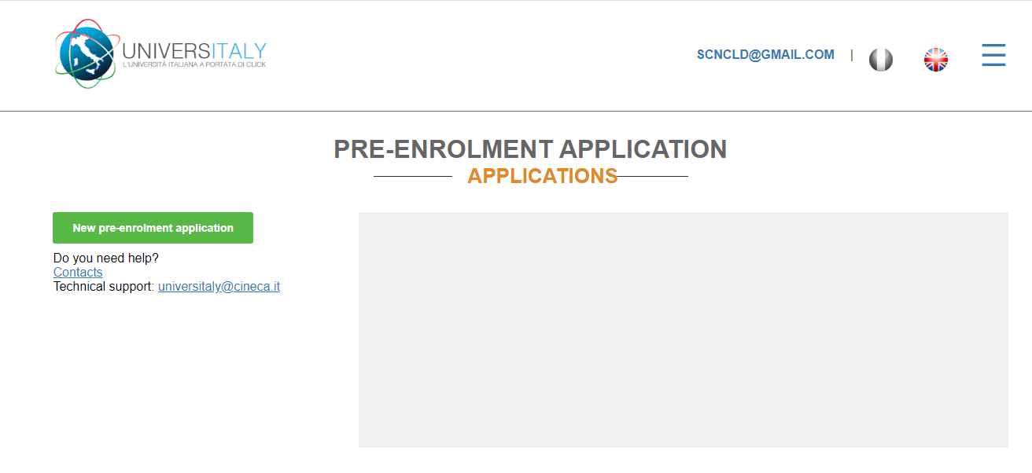
Application: contacts
HELP contacts:
Technical support: universitaly@cineca
University contact:
Master.ateneo@univpv.it
Please note that at one point you will be asked which embassy or consulate you are going to use for your visa application.
To find out more before applying go to https://vistoperitalia.esteri.it/home/en

Slide 10
Application: Step A
Step A:
Personal Data and Official Home Address
Copy your data from your passport
Check your data and go to Step B

Slide 11
Application: step B
Step B:
Upload:
your photo
your passport
Visa application
if you are in doubt check here:
https://vistoperitalia.esteri.it/home/en

Slide 12
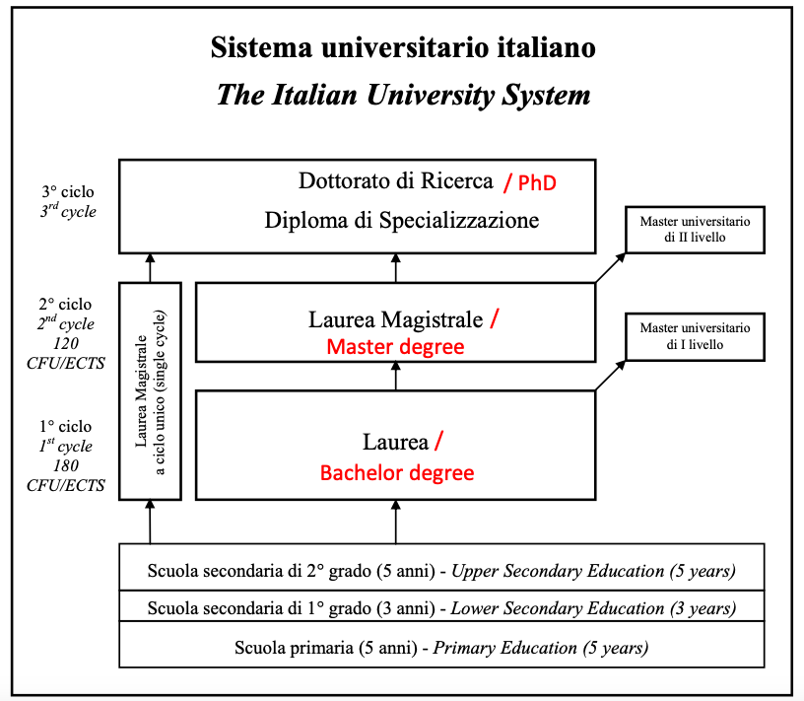
Application: step B
Select the University of Pavia as Institution and the Course type and name
(Consult the Italian University System framework if in doubt of which course type to choose)
Ignore the code request and go to step C
NB: The course in Medicine and Surgery is a 6 year “Laurea Magistrale a Ciclo Unico”.

Slide 13
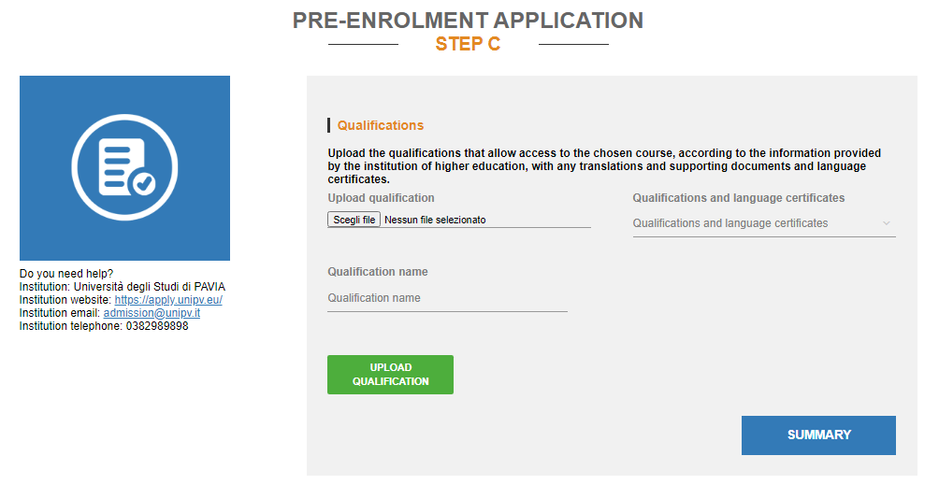
Application: step C
Step C:
Upload your qualifications (preferably: study title diploma, transcript of record, CV)
and check your data in summary

Slide 14
Application: summary
Summary example

Slide 15
Application: disclaimer and data processing
Please read this part carefully before submitting.
Please note that when you select «I have read the data processing»
You will ask to read an additional document on the italian privacy law
Once you have checked everything apply!
Your application will be sent to us.

Slide 16
Thank you for choosing the University of Pavia !

