Slide 1
Acceptance and rejection of the candidacies
Gruppo GEA - Cineca

Slide 2
Acceptance of the candidacies
When including candidates in the list, the presenter of the list shall invite candidates to present themselves for his list. The candidate can then either accept or reject this invitation.

Slide 3
Acceptance of the candidacies
The main steps in the candidacy process are as follows:
Login to the system
Select the Invitations button
Select the candidacy
Accept or reject the candidacy

Slide 4
Acceptance of the candidacies
Login to the system
Access the Reserved Area using your university credentials
Display the Menu (right-hand side)
Click on «Student elections»

Slide 5
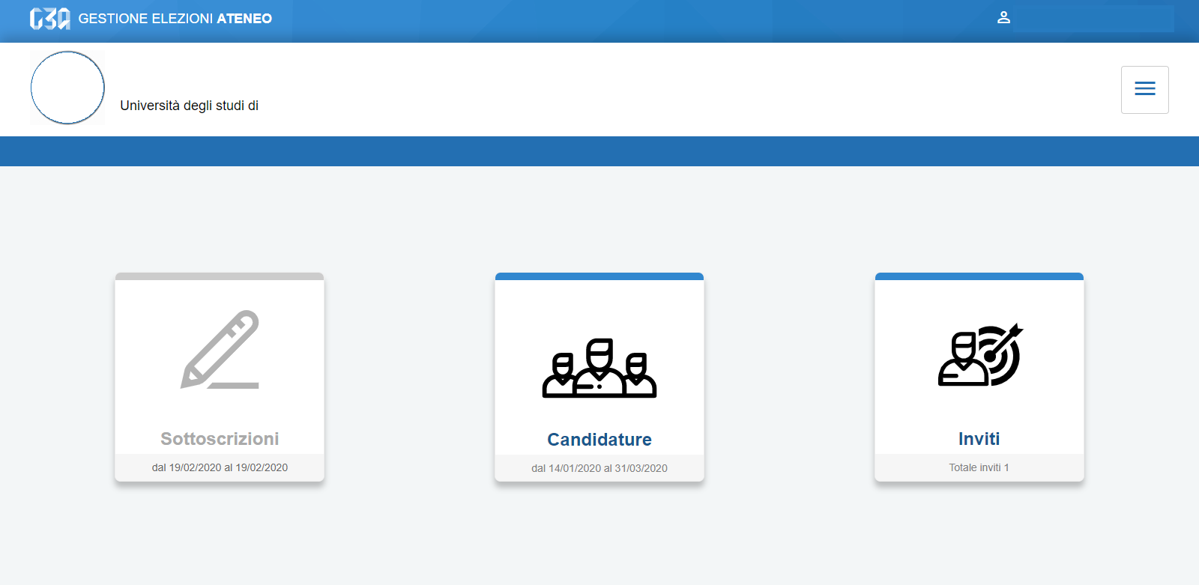
Acceptance of the candidacies
Select the Invitations button

Slide 6
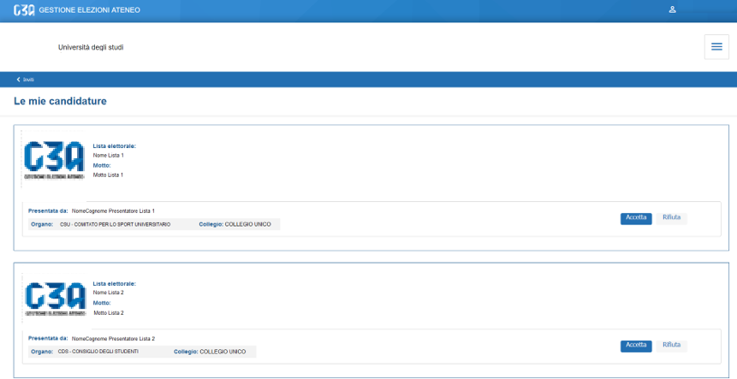
Acceptance of the candidacies
This section lists all the candidacies received from the student
If the student receives two or more candidacies from different bodies, he can accept them all, reject one, or reject them all

Slide 7
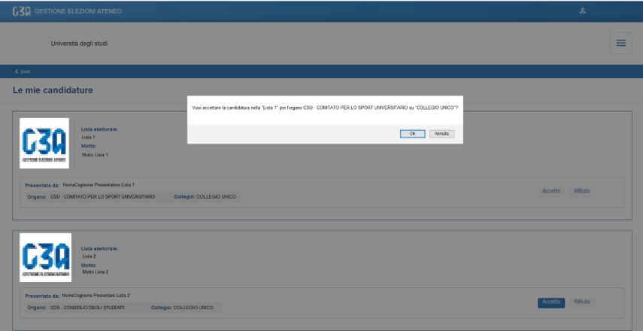
Acceptance of the candidacies
In case of acceptance of the candidacies from List 1
By clicking on «Accept», a message confirming acceptance appears

Slide 8
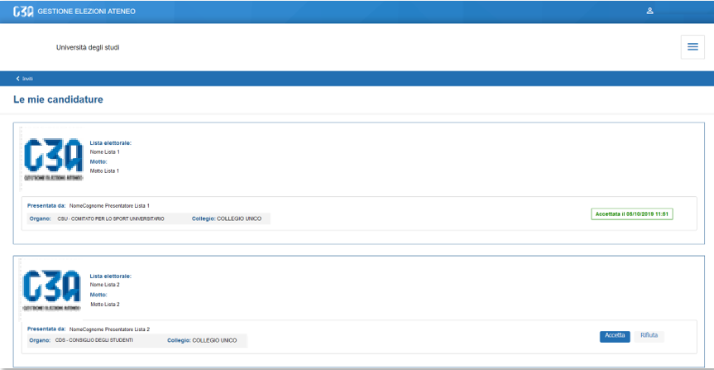
Acceptance of the candidacies
The candidacy is confirmed

Slide 9
Rejection of the candidacies
In the event of refusal of the candidacies for List 2
By clicking on «Reject», the rejection message will appear

Slide 10
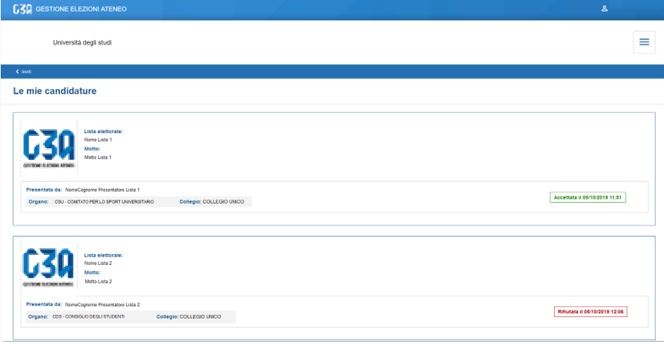
Rejection of the candidacies
The candidacy is rejected

